Slide 1

LHS K12 Program
Leading Change
Portland, Oregon
November 17, 2021
Janet Porter, PhD
Adjunct Professor
Ohio State University
University of North Carolina
janetporterphd@gmail.com
843-671-2079

Slide 2
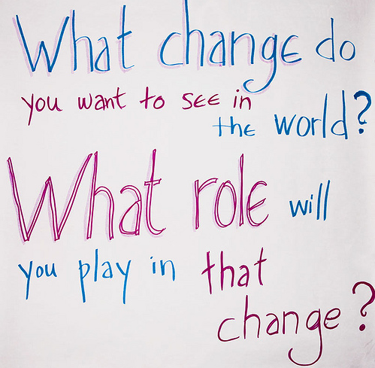

Slide 3
Today’s Learning Objectives
To develop an appreciation of the importance of investing in your leadership development
To become skillful at working with the C-suite to invest in research development and translation

Slide 4

Embracing Change
Everyone thinks of changing the world, but no one thinks of changing himself.
Leo Tolstoy

Slide 5
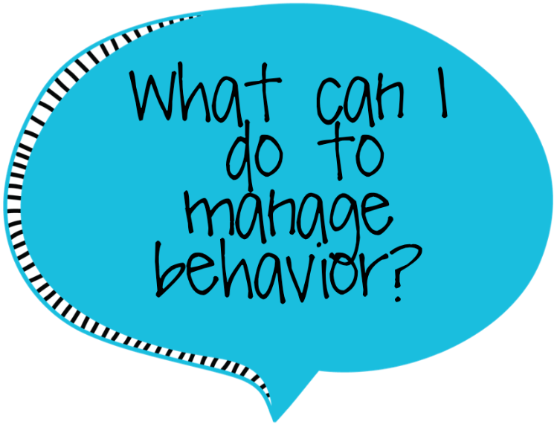
To change a habit, make a conscious decision, then act out the new behavior.
Maxwell Maltz

Slide 6
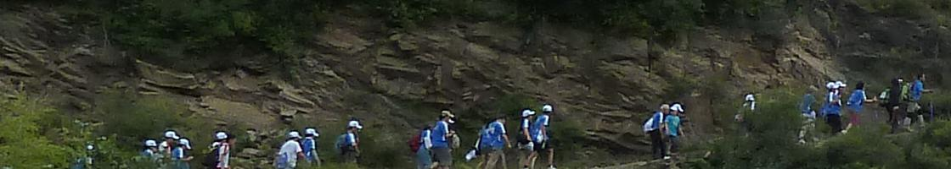
Leadership
If you think you are leading,
look behind you,
if there is no one there, you are not leading,
you are only taking a walk.

Slide 7
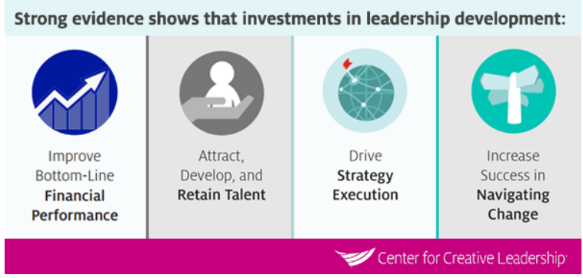
Reflection
Deliberate practice
Coaching
Repeat

Slide 8

Grit
Grit is passion and perseverance for long-term goals
Grit is having stamina
Grit is sticking with your future day in and day out, not just for the week, not just for the month but for years….and working really hard to make that future a reality
Grit is living life like it is a marathon, not a sprint
You improve by deliberate practice and knowing your passion and focus
Angela Duckworth – grow resilient children

Slide 9
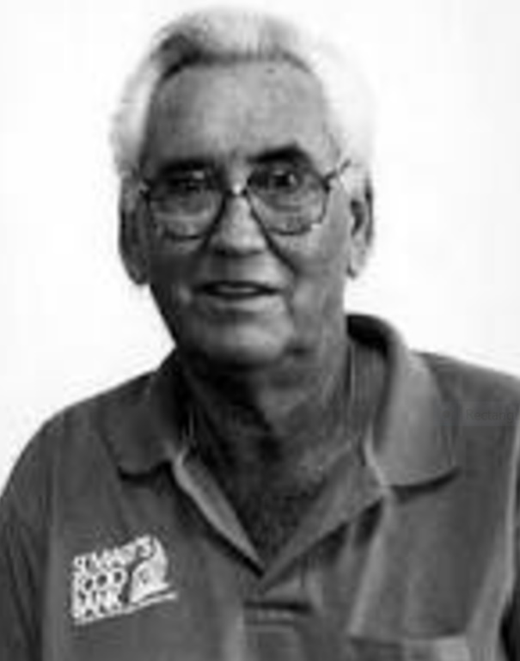
John Van Hengel
Born in Wisconsin, son of a nurse and pharmacist
Graduated from college, became beach bun
Married, two sons, divorced
Injured working in a rock quarry at 40
Age 44 took a vow of poverty
Lived in donated room above garage, secondhand clothes, ate at soup kitchens
Founded first food bank in America – St. Mary’s in Phoenix - 1967
“Father of Food Banking”
Started Second Harvest
Mother Teresa Lifetime Achievement Award
Humanitarian Congressional Award
Knighted

Slide 10
Testimonial
Thank you so much for your presentation on Friday. It was so timely given all the change and uncertainty in our organization right now. I left feeling inspired and ready to change my outlook. Yesterday I had a meeting with my new boss whom I have had trouble connecting and communicating with him. Your talk and activities on influence and reception reinforced past learning on communication styles and I was able to adapt my communication style to his and have my most effective meeting with him yet! During my hour commute home Friday I was also able to reflect on what I am passionate about, how do others perceive me (thinking about the list you shared on knowing if you have influence), and how I want others to perceive me. I realized I have been in a victim mindset and not the assertive, positive, and influential leader I want to be and know I can be and have been in the past. I am now excited to take on the current and future challenges at Kaiser with a more positive mindset of taking charge and leading versus waiting for others and being a victim. Thank you so much for this timely discussion. It has really ignited a new passion for me in the work I do.

Slide 11
Today’s Learning Objectives
To develop an appreciation of the importance of investing in your leadership development
To become skillful at working with the C-suite to invest in research development and translation

Slide 12
Taxonomy of Decision-Making Models
Rational Organizations
Bureaucratic Organizations
Political Organizations
“Garbage Can” Organizations
Notes:
Janet

Slide 13
What Factors Drive Which
Model is Used?

Slide 14
Factors Determining Model
Mission, Values, Culture, Leadership Style
Financial Drivers of Organization
Time
Key Stakeholders
External Environmental Factors
Primacy and Recency

Slide 15
Taxonomy of Decision-Making Models
Rational Organizations
Bureaucratic Organizations
Political Organizations
“Garbage Can” Organizations
Notes:
Janet

Slide 16
Conditions for the Use of Power
Interdependence
Heterogeneous
Goals
Scarce
Resources
Conflict
Importance
of Decision
Distribution
of Power
Use of Politics
Notes:
Janet

Slide 17
Know Your Organization
Assessing Decision-Making
How do decisions get made? Programmatic? Capital? Operating? FTEs?
Who are the key stakeholders? What is their relative position on research? What do you know about their decision-making?
What are the organizational priorities and goals? How can your work support those goals and priorities?
What are the forums (meetings, other) where decisions get made? What is the structure in those forums?
Notes:
Janet

Slide 18
Stakeholder Analysis
Who are the key stakeholders?
What is their power base (expert, positional, reward, relational, etc)
What is their position on your work?
Who could most influence them?
What is your strategy?

Slide 19
Questions to Ask Yourself
Have we engaged key stakeholders?
What is the influencing style of those stakeholders?
How does my “ask” fit with goals, priorities?
Have we prepared the programmatic request in accordance with practice?
Have we explained the need, the gap, the program, the phasing, the cost, outcomes clearly?
Have we provided benchmarks?
Notes:
Janet

Slide 20
Ways to Tell if You have Influence
Can work around policy or rules
Access to vital information
Sought out for advice
Involved in important decisions
Can influence a change outside your role/area
When you speak people listen
Access to resources
cc’d on correspondence
Given an important responsibility/promoted
Targeted for development
Asked to coach/mentor others
Included in special events – work and non-work related
Frequency with which senior managers show up at your desk

Slide 21

To Influence Effectively
Speak their language (Dr. Susan Block)
Understand and personally align to the organization’s direction and priorities and culture and values
Illustrate, translate how your work supports organizational goals
Take action even if you don’t have the authority over resources – demonstrate success, get results (Lori Roop)
Make your great outcomes visible (Dr. Kaminski)
Inspire/recruit champions and followers (Bill Jennings)
Build confidence through proven execution (Sarah Kadish)
Reflect, reflect, reflect (Dartmouth)
Use effective communication strategies (Ice bucket challenge)

Slide 22
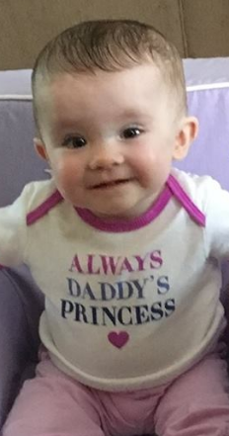
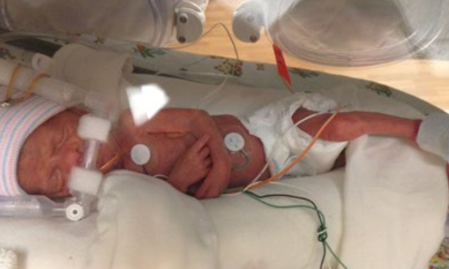
Never believe that a few caring people cannot change the world. For in fact, that is all who ever have.
Margaret Mead

Slide 23
